Slide 1



grip_task5
View in Power BI
Last data refresh:
9/25/2020 11:14:47 PM India Standard Time
Downloaded at:
9/28/2020 2:03:35 PM India Standard Time

Slide 2
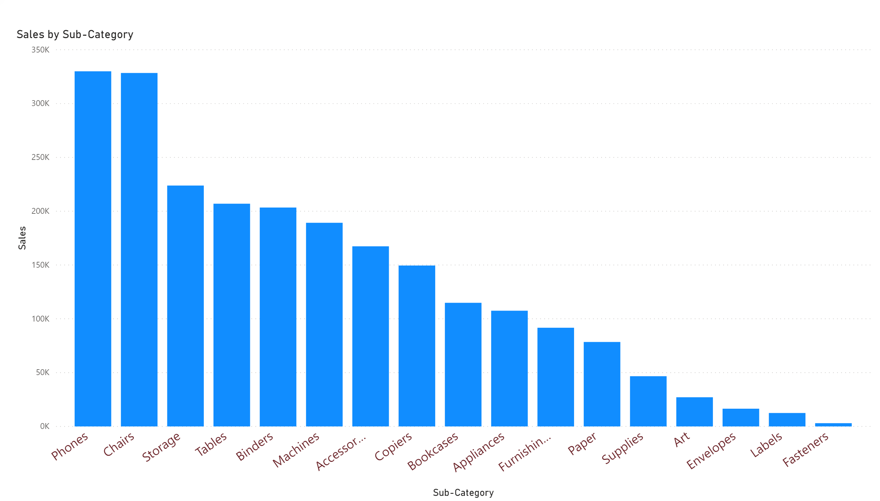

Slide 3
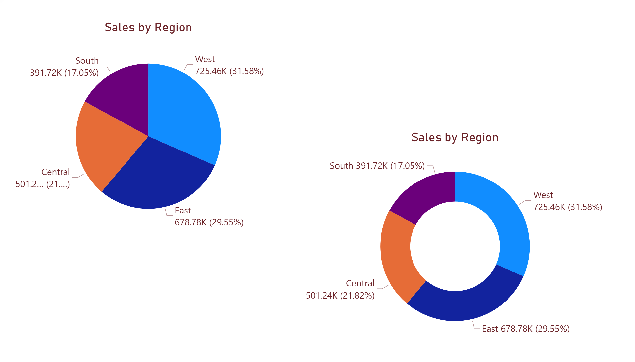

Slide 4
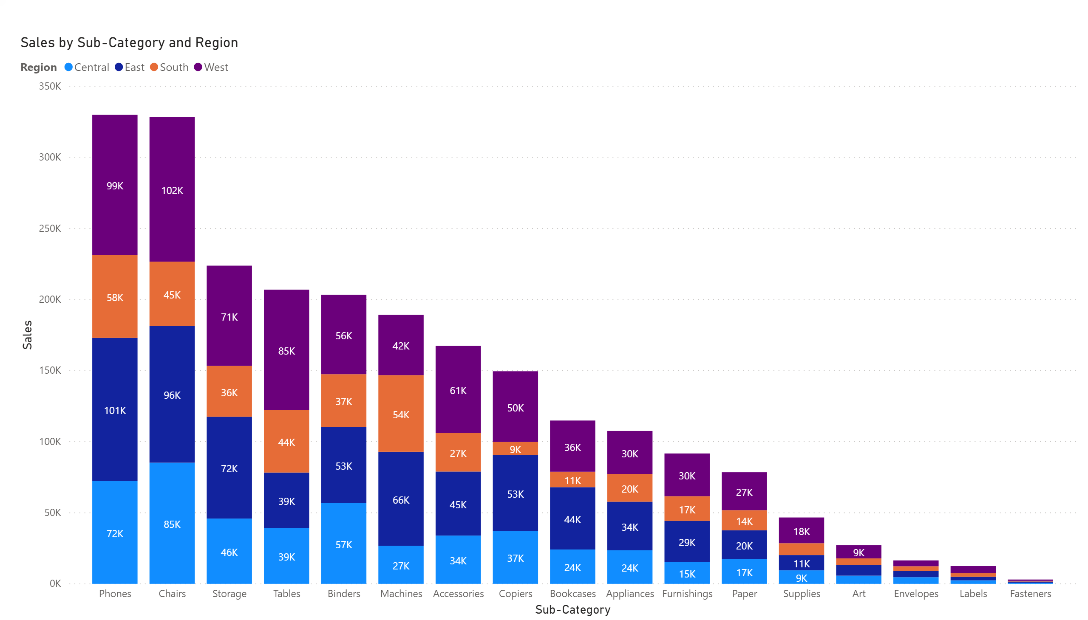

Slide 5
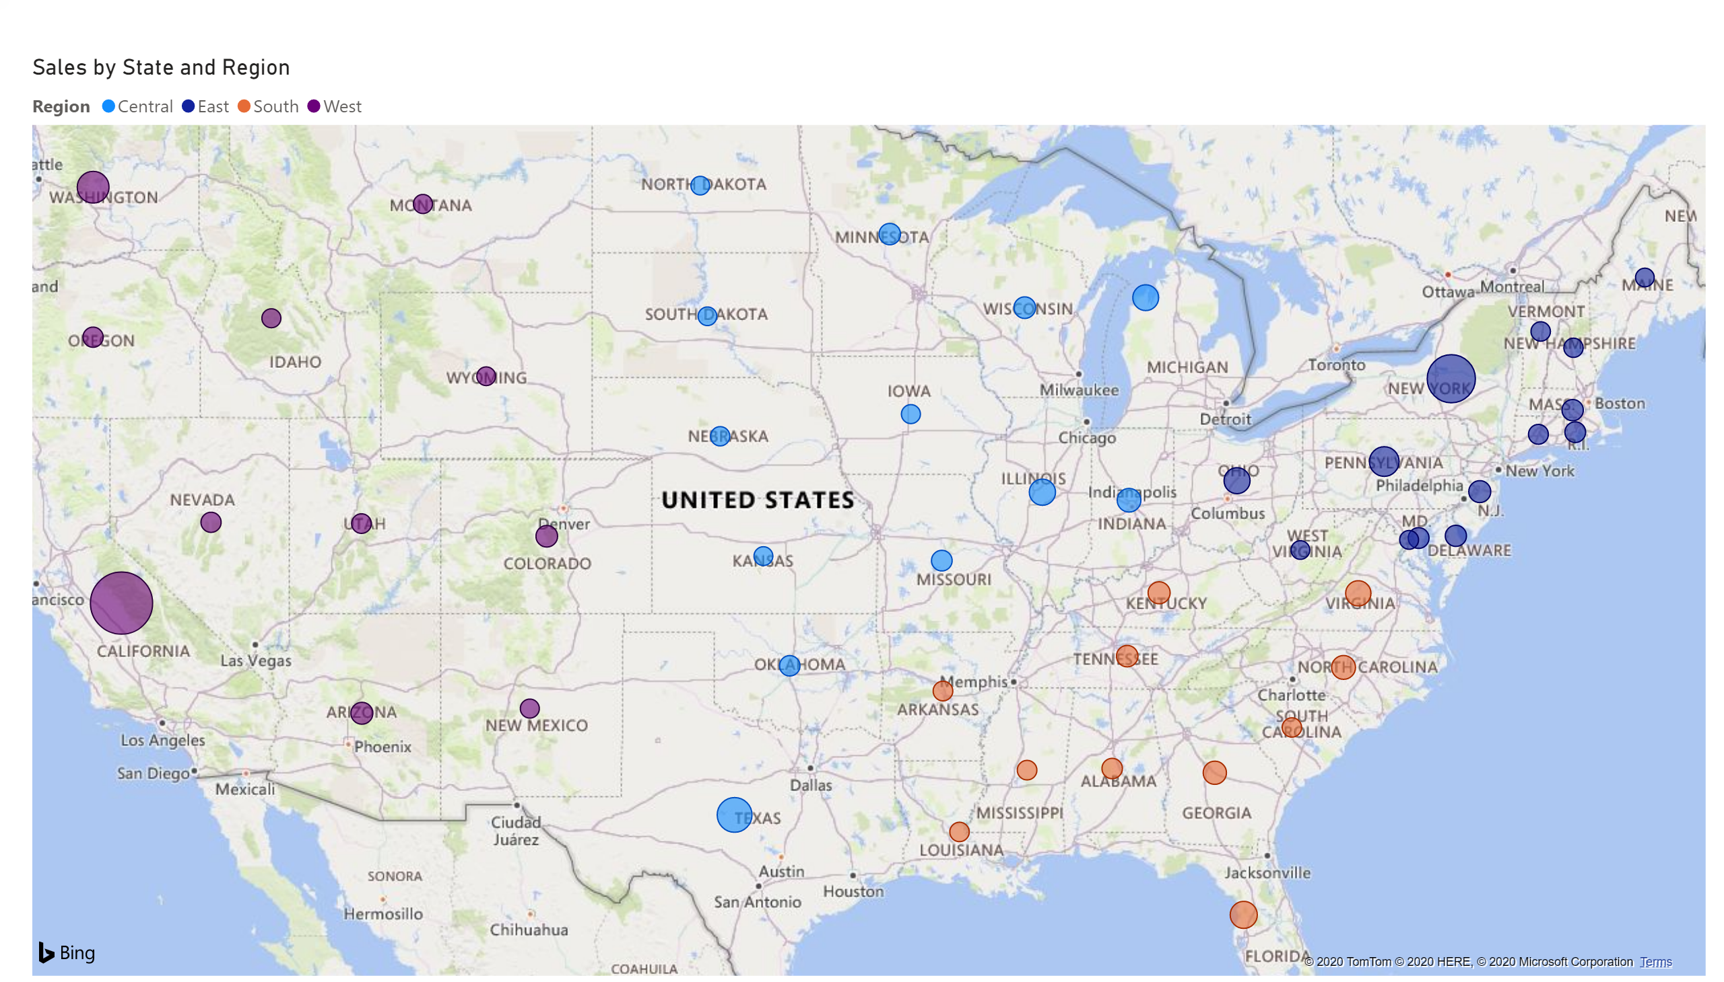

Slide 6
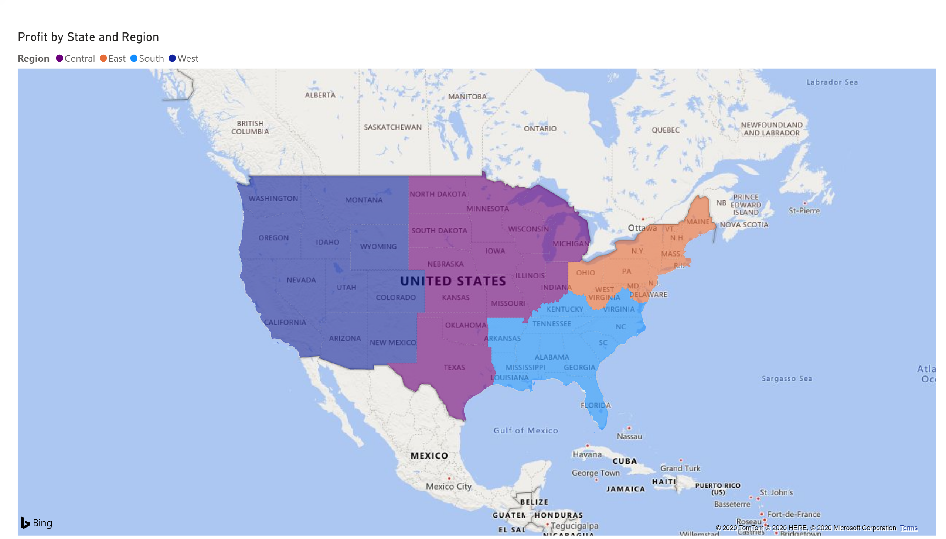

Slide 7
